Slide 1
Appendix E Common data models
JI-HAN JIANG
Source: Database Solutions a step by step guide to building databases

Slide 2
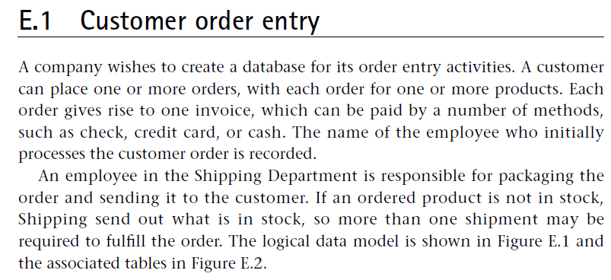
Common data models-1

Slide 3
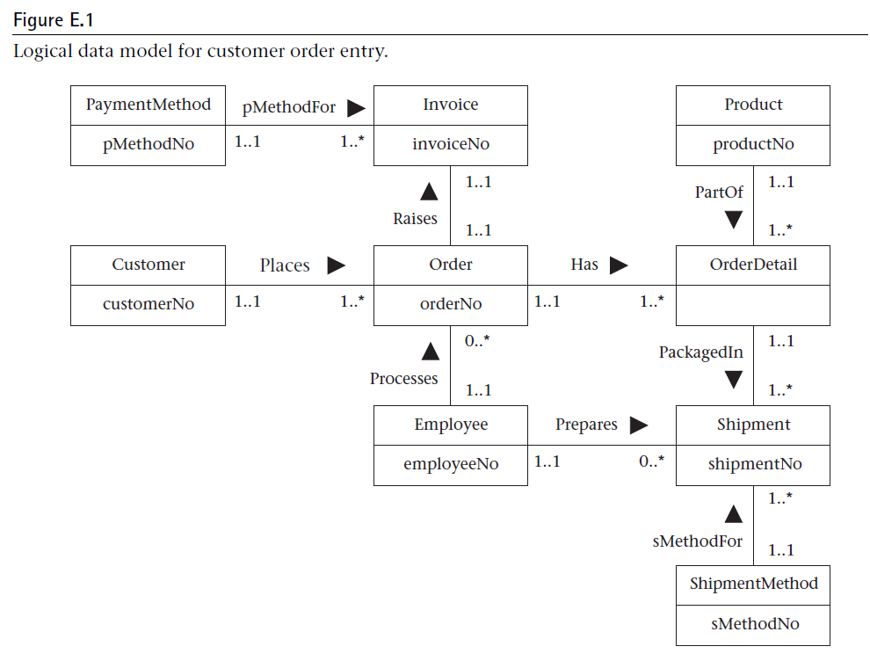

Slide 4
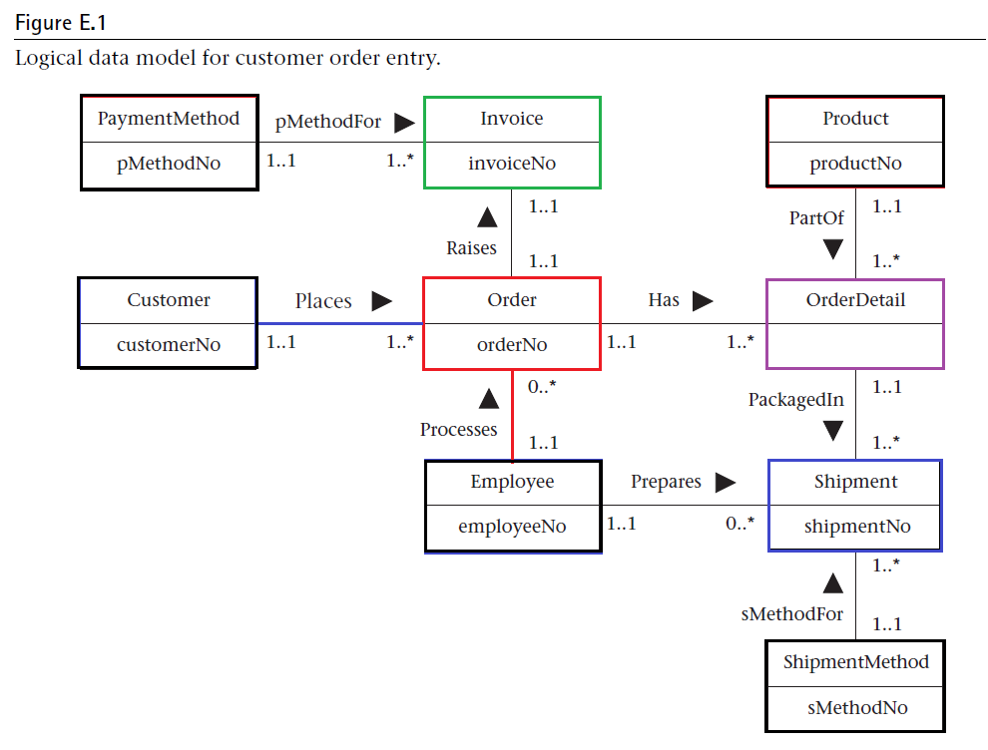
1
5
1
1
2
3
0
4
1

Slide 5
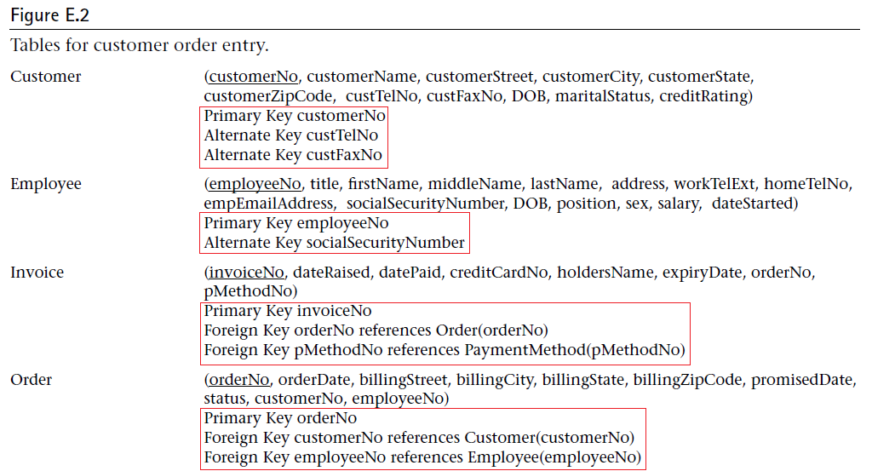

Slide 6
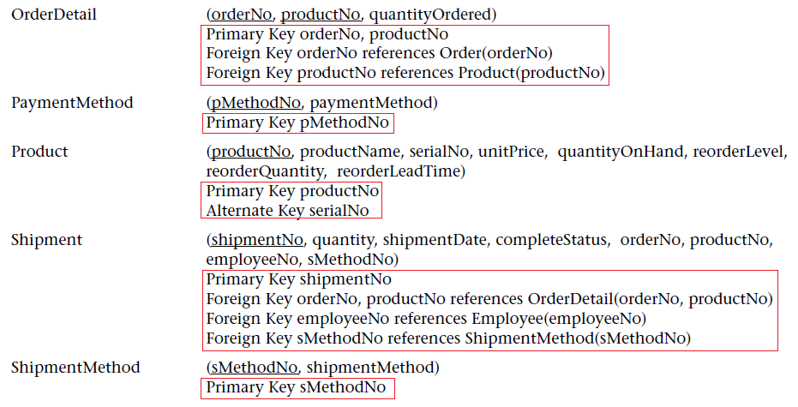

Slide 7
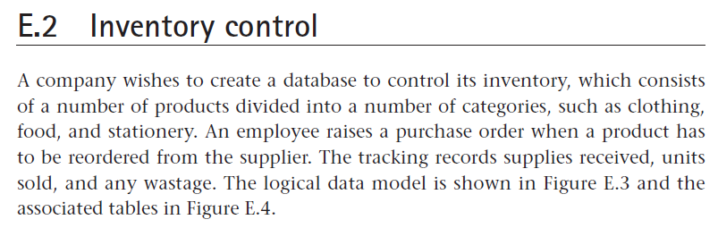
Common data models-2

Slide 8
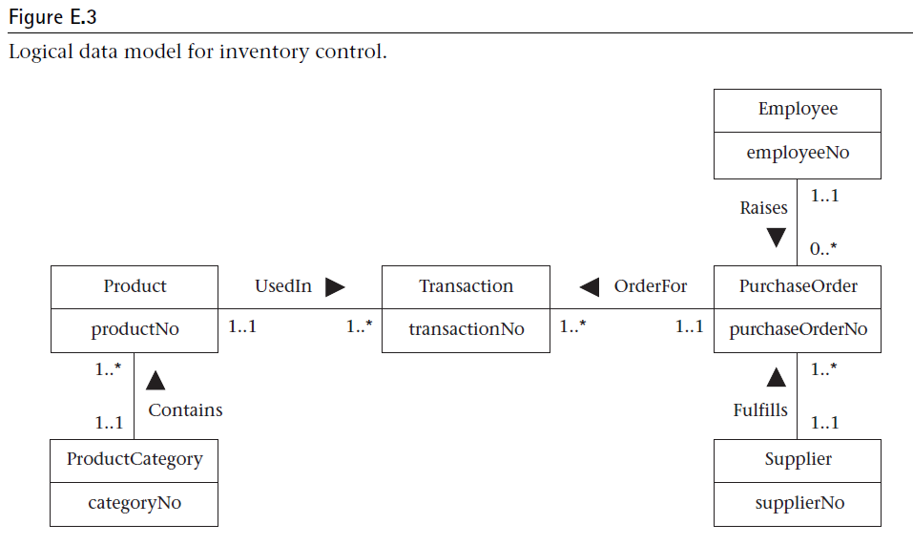

Slide 9
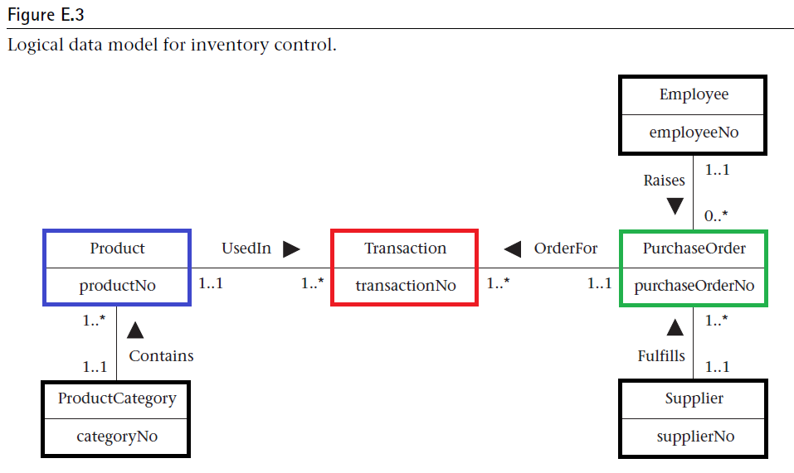
0
1
3
2
0
0

Slide 10
